Slide 1
Python programming
unit 3 program practice

Slide 2
Define your own function
Define a function countBs(), which accepts a string as argument, and return how many ‘B’ in this string.
Define a new function countChars(), which accepts one more argument, this second argument is a one letter string, specify which character want to count. And the function will return how many this character in the string.
Try to use the second function, to make a new countBs function.

Slide 3
Define your own function
Define a function, useonly, which takes 2 arguments: the 1st will be the word to check, the 2nd will be a sequence of letters.
The function will check if the word only contain letters from the sequence, no other letters. If True then return True, otherwise return False.
Define a function, useall, which takes 2 arguments: the 1st will be the word to check, the 2nd will be a sequence of letters.
The function will check, if the word used all the letters in the sequence. (if also used some other letters outside of the sequence is ok). If True then return True, otherwise return False.

Slide 4
Define your own function
Define a function, isabecedarian, which takes argument: the word to check.
The function will check if the letters of the word appeared according to alphabetic order (double or triple letters are ok). If True returns True, otherwise returns False.
Define a function, avoids, which takes 2 arguments: the 1st is the word to check, the 2nd is a sequence of letters.
The function will check if the letters of the word contain any of the letters from 2nd sequence. If does not have any, it returns True. If has, then return False.

Slide 5
Judge number is even or odd – use recursion
Number is 1, it is odd
Number is 0, it is even
For any number n, it is same even or odd as n-2
Use the above rule to define a function, which can recursive call and give a judgement one number is even or odd.
Test your function.

Slide 6
Number puzzle
Number sequence.
The first number is 1.
The next number is calculated based on the previous number. You can either choose to multiply by 3, or choose to add by 5.
Now give a number, can you make a program to judge if this number is inside one of the above sequence? If it is can you find a sequence which can produce this number?

Slide 7
combination
Combination: how many ways to take out things from a set of items.
You have {a, b, c, d, e}, 5 things.
Now you want take out 1 from the 5. how many ways you can do? Answer: you have 5 ways.
Now you want take out 2 from the 5. how many ways? Answer: Then total ways is 10. they are {a,b}, {a,c}, {a,d}, {a,e}, {b,c}, {b,d}, {b,e}, {c,d}, {c,e}, {d,e}
Make a program to list all the ways? (from n items to take m items, m<=n)

Slide 8
Permutation of letters
Write a program, which takes many different letters from user. Use ‘0’ as indication of end.
The program output all possible string using those letters. (use at least one letter, up to all letters been used.)

Slide 9
permutation
In the combination problem, if the item you take out the order is important, then it becomes permutation problem.
Example: for taking 2 items, {a, c} and {c, a} are considered different.
Can make a program to list all ways?

Slide 10
nestsum
Create a function called nestsum.
The function takes a list and if the list has nested lists, will sum over all of them (nested lists) and calculate the sum of all items.

Slide 11
File operation
You have many files, each file contains synonyms for one word. For example, for word ‘educate’, the file ‘educate.txt’ will have all synonyms for it, and is ordered in line, each line start with one letter.
Inside educate.txt:
When input:
Program will output:
better
coach cultivate
drill develop
enlighten edify elevate
guide
instruct inform inculcate indoctrinate improve
prepare prime
school
teach tutor train
upskill uplift
educate
c
educate
h
coach cultivate
No synonym begin with “h”

Slide 12
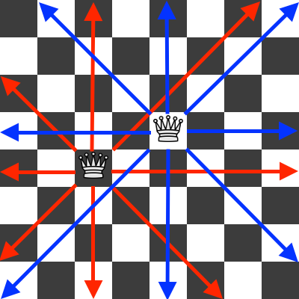
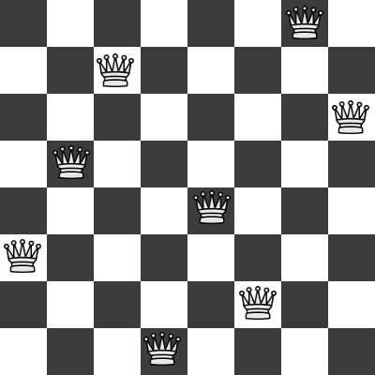
8 Queen puzzle

Slide 13
Queue simulation program
Create a program of simulation.
Every minute comes a random number person of (0~5), to queue and buy coffee.
Every guest takes around 15 ~ 20 seconds to finish service.
Observe how the queue depth changes with time.
Record and study each person’s waiting time.

Slide 14
stack simulation program
Create a program of simulation.
Every day comes a random number of files waiting to be signed (0~10), which was put on a table.
Every day take 6 files from table, process and sign it.
Observe how the stack depth changes with time.
What if you feel not work and work efficiency reduce to only process 4 files one day?
Record and study each file waiting time.

Slide 15
What is in the backpack
Create 2 players for the game. Each player has 4 items in his/her backpack
Each player plays in turn. When one player plays, guest what is in the other player’s backpack. If guess correct, that item was removed from other player’s backpack.
Until one player’s backpack is empty, he/she lose the game.

Slide 16
Flow chart for the game
START
2 player user name and backpack items
One round play: user 1 guess
Y
Correct guess?
Update score, remove user 2 backpack
N
One round play: user 2 guess
Y
Update score, remove user 1 backpack
Correct guess?
N
Any user backpack all finish?
Y
N
Next round?
Y
N
Show score and results
END

